Slide 1
TAFE
2020-2021 Theme is
“Oh, the Places You’ll Go with Teaching”

Slide 2
What is TAFE?
TAFE is composed of local chapters from high schools and middle schools throughout the state. The State Organization exists to provide services to the local chapter and community, thus promoting teaching as a profession.

Slide 3
Why Join?
Looks good on transcripts
Most educational colleges look to see if you were involved in an education group in high school
TAFE is NATIONALLY known
If you are going into education this organization helps prepare you
Seniors receive a graduation cord IF the requirements are met

Slide 4
Goals
To recruit qualified youth to become teachers, to help eliminate the shortages within the profession and to strengthen requirements for teacher candidates.
To provide students with experiences in high school that will keep them committed to becoming teachers throughout their college career.
To strengthen the image of the teaching profession through providing information and counseling to students.
To encourage personal growth of future educators through participation in region and state meetings, organizations and workshops.
To increase student involvement and foster pride in their school and community while contributing to the educational experience.

Slide 5
What is required from you?
Membership fee of $5 due September 7th
Attend TAFE Tuesday meetings from 4pm-5:30pm once a month
Regional Registration fee of $25 and commitment to compete contract Due Sept 21st
You are doing the work on your own and on TAFE Tuesdays
Region Competition November 2nd
State is February 27th ~ March 2nd
If you advance to state their will be a mandatory parent and student meeting on February 5th at 6:30pm
Your time! We will be doing community service projects, meetings, fundraising and project completion.

Slide 6
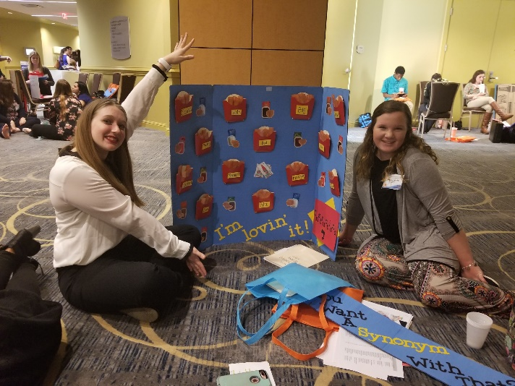
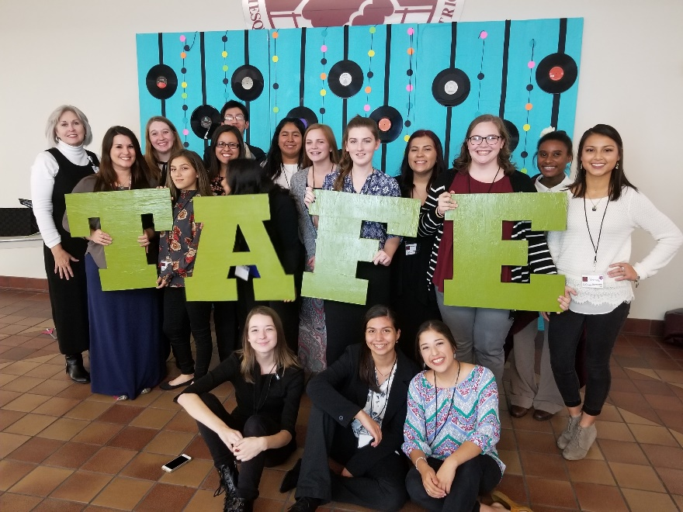
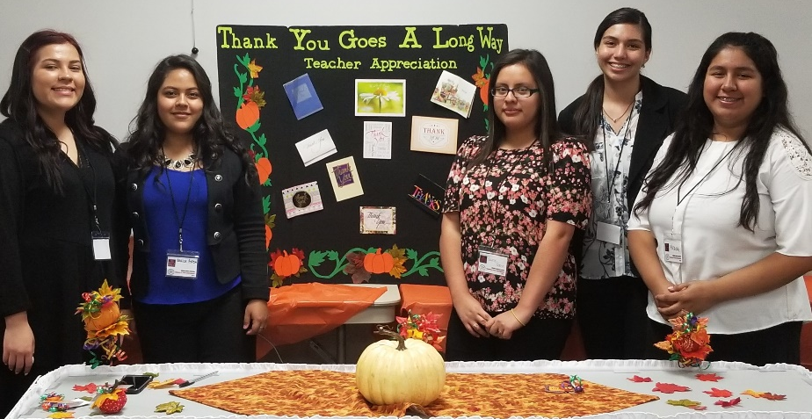
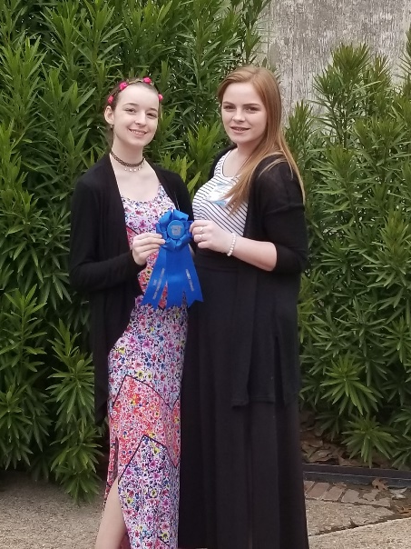
Regionals and State Competitions

Slide 7
TAFE Pledge
As a TAFE member, I hereby pledge to promote positive attitudes regarding all noble aspects of education, to acknowledge the challenging role of the teaching profession, and to provide service and leadership within my school and community.

Slide 8
Important Dates
August ~ First TAFE meeting of 2020-2021
Date TBD ~ Regionals in Mesquite, Texas
March 4th -6th ~ State in Round Rock, Texas

Slide 9
Important Topics To Discuss
Officers
Hours for Badges/Ropes
http://www.tafeonline.org/leadership-framework-
Shirts
http://www.tafeonline.org/guidelines-rubrics
One big community service project a year and one little project each month

